Slide 1
Research Project Workshop 08/09
Scholarly Communication
July 5, 2017
Instructor(s): Robin Champieux, MLS & Letisha Wyatt, PhD

Slide 2
roadmap
1 | Considerations for cultivating your scholarly presence
Who
Why
How
2 | How to build a better biography – we’ll do it together!
3 | Refining and expanding on your initial efforts
Notes:
You’ve probably heard the term scholarly communication? What does that make you think of? What does that mean to you?

Slide 3
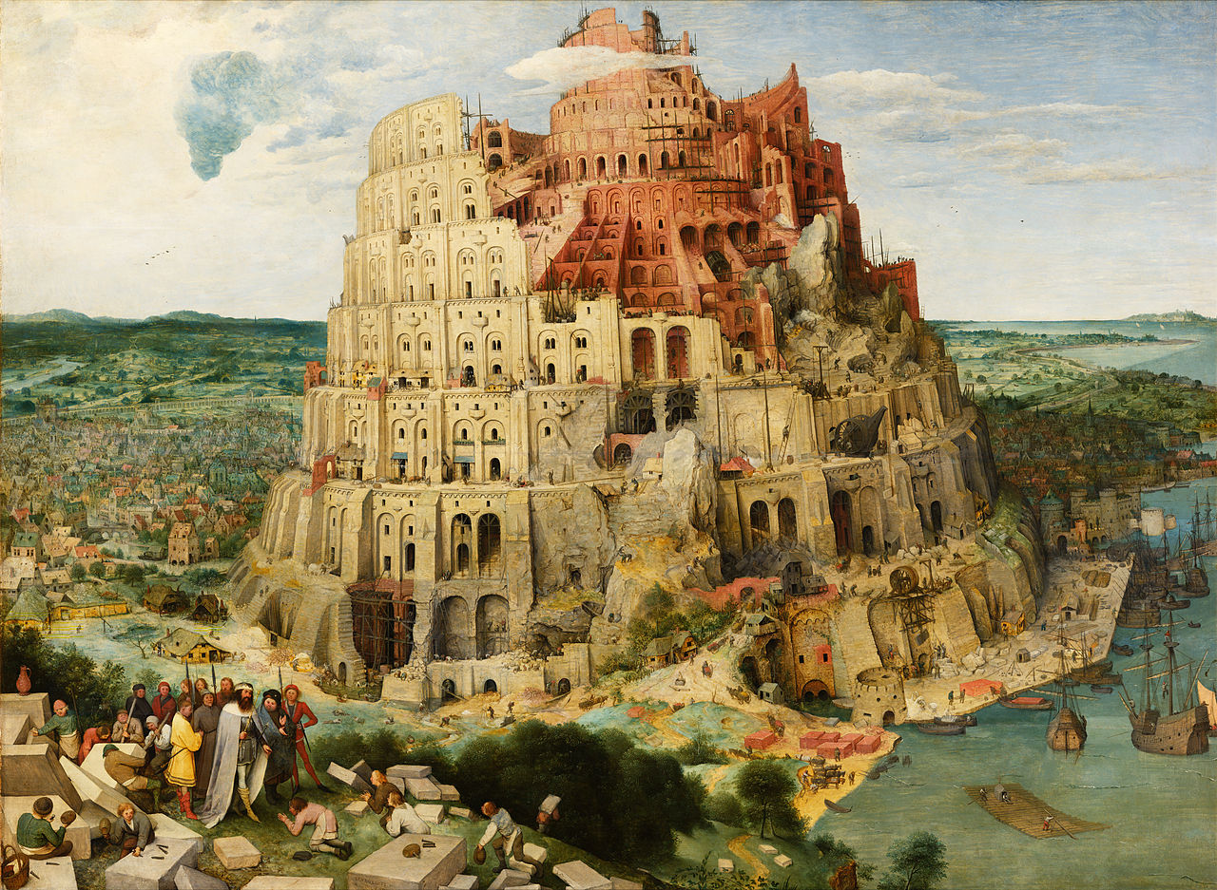
Source: Wikipedia
Notes:
why are we talking about scholarly communication? there’s a process for it (some people get paid for scientific outreach). Need to be proactive/thoughtful in order to be successful – “communication” is a key part of this.

Slide 4

ADMISSIONS
PEERS
FUNDERS
EMPLOYERS
POLICY MAKERS
THE PUBLIC
PARTICIPATE: What are each of these groups looking for anyway??
Notes:
WHO might you be looking to reach and why?
WHY (think also about what your reader wants as in why might they want to read your work and how to align your wants and their?)
Emerging policies and processes, and public discourse illustrates the attention important stakeholders are giving to scientific communication and the outcomes it effects.
Funder interest in broader impacts is rising. In addition to their intellectual merit, many funding applications are evaluated for a project’s potential contributions to public scientific literacy, partnerships between academia and industry, policy, and professional practice. And, the new NIH Biosketch emphasizes narrative descriptions of a researcher’s influence and a more inclusive view of supporting materials. Many of your are likely to pursue careers outside of academia or a lab. These employers care about your online reputation.
Being more strategic about where and how you share and communicate about your work can help you meet your broader communication and impact objectives.

Slide 5
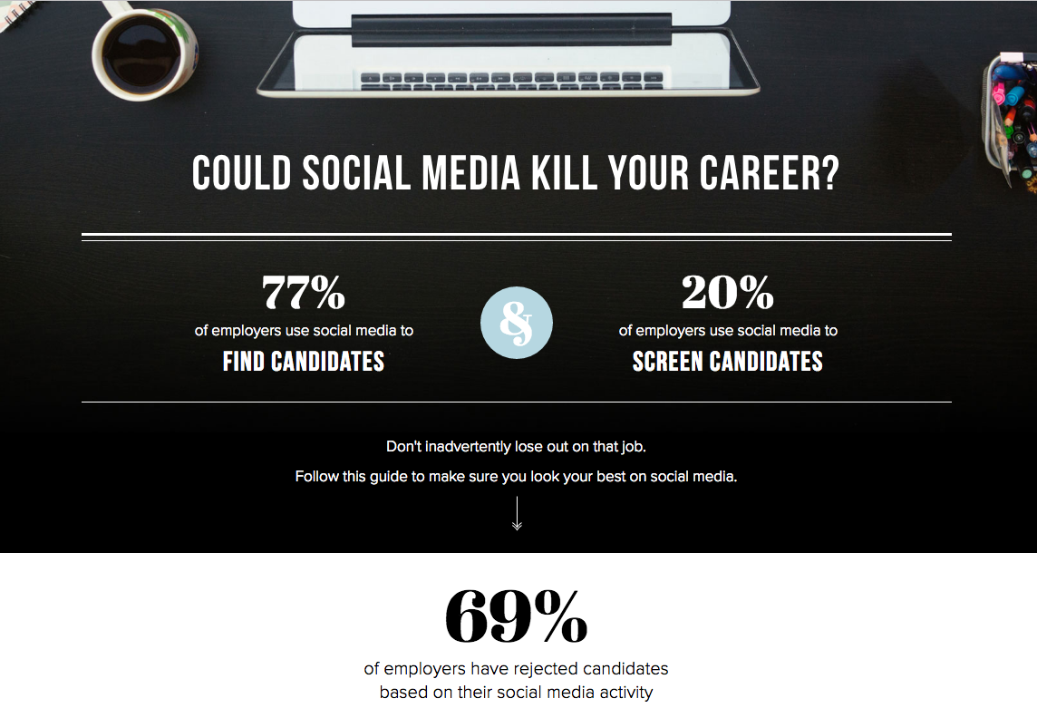
social media: friend or foe?
http://www.michaelpage.co.uk/minisite/optimise-social-media/

Slide 6
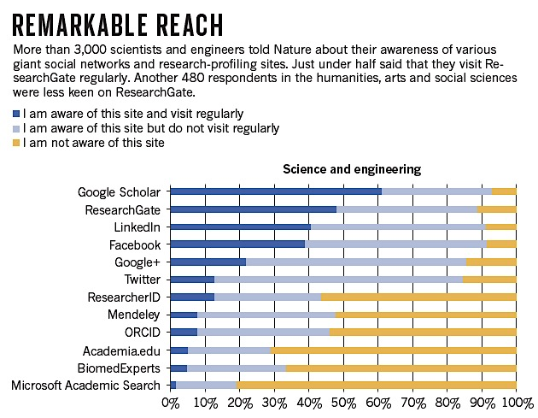
http://www.nature.com/news/online-collaboration-scientists-and-the-social-network-1.15711
Notes:
We’re also seeing evidence of the use and influence of Academic and popular social networking sites on scientific communication.
In 2014, Nature publishing surveyed 3,500 academics from 95 countries. Over 60% of the scientists and engineers that responded reported using Google Scholar on a regular basis; and over 40% reported using ResearchGate on a regular basis. And, 13% said they use Twitter on a regular basis, as tool for both following and commenting on research related to their field.

Slide 7
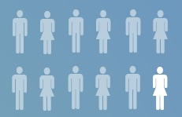
academia…or not
<8%
of entering PhD students will be come TT faculty
70%
do postdocs
Adapted from: Infographic by Jessica Polka of where biology PhDs end up based on the NIH 2012 workforce report
Notes:
Your training may not necessarily take you down the academic path (no surprise!).
Though the stats show that few become TT faculty, the majority of PhD prepared individuals go on to a postdoc which is traditionally considered preparation for an academic position.

Slide 8
22,500
industry research
22,500
gov’t research
24,000 non-research science
17,000
non-science
Adapted from: Infographic by Jessica Polka of where biology PhDs end up based on the NIH 2012 workforce report
Notes:
Many opportunities are outside of academia -> examples
Nonetheless, for all of the potential jobs:
Employer/Funder interest in broader the broader impacts of your work is rising = more often applications are evaluated for a project’s potential contributions to improving or creating clinical outcomes.
NIH = focus on a proposal’s scientific significance and importance to a specific field

Slide 9
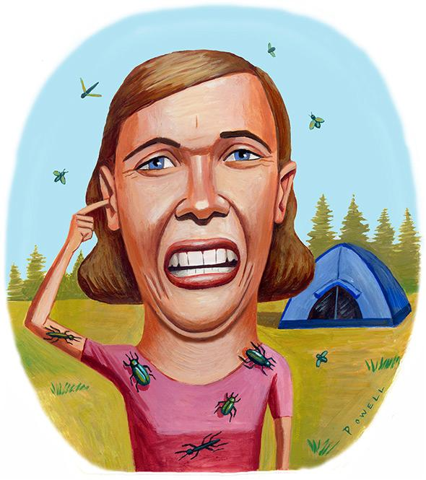
BUT, ONLINE OUTREACH IS WORK
Illustration by Charlie Powell via www.state.com
IS THE PAYOFF MORE THAN BUZZ?
Notes:
But it is work, and there’s typically an upfront time commitment. Is the payoff real? Is it more than just buzz and can it help drive the kind of success that will get you funding, a job, or find you a new collaborator?

Slide 10
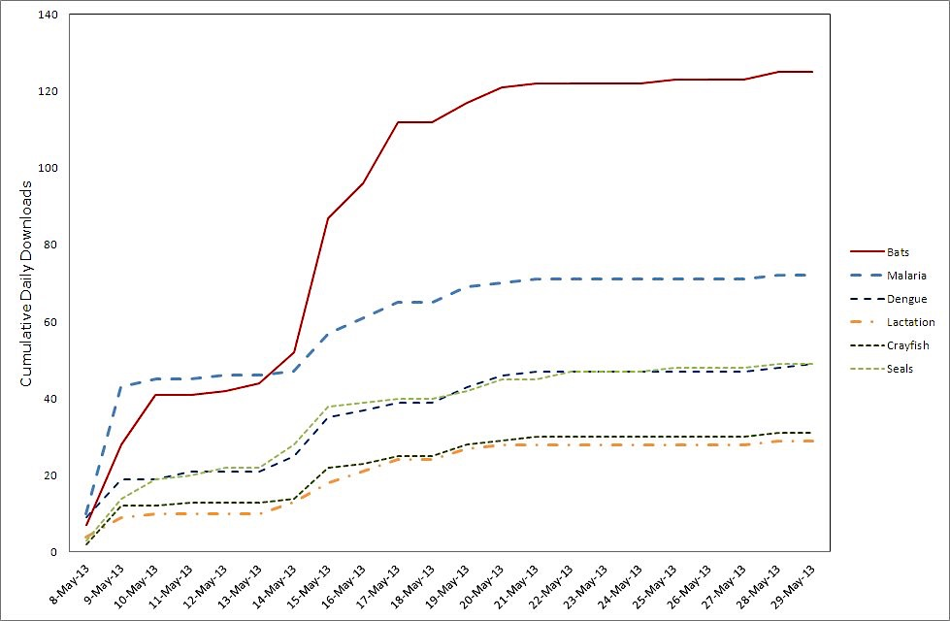
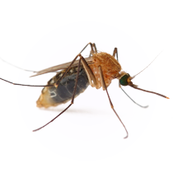
https://cameronwebb.wordpress.com/2013/06/05/can-social-media-increase-the-exposure-of-newly-published-research/
Notes:
A growing body of systematic and anecdotal data indicate that it can help. As you may know, for better or for worse, citations are the gold standard for evaluating the impact of an individual scientific article. Recently, Dr. Cameron Webb, a medical entomologist at the University of Sydney, wanted to see if promoting his paper on social media would have any effect on the attention his paper received.
This figure shows the downloads his paper, Foraging Ranges of Insectivorous Bats Shift Relative to Changes in Mosquito Abundance, received after his efforts compared to five other papers published on the same day on in the same journal. As you can see his paper got a lot more attention.
But how do downloads relate to citation counts? Well, numerous bibliographic studies have shown a strong a correlation between downloads and later citation counts. For example, in a study of Nature Neuroscience papers, a correlation of 0.72 was found between citations and PDF downloads in the first 180 days of an article's lifetime: http://www.nature.com/neuro/journal/v11/n6/full/nn0608-619.html

Slide 11
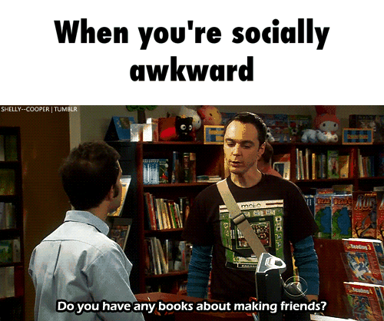
WHEN YOU WANT TO BUILD YOUR NETWORK
Attribution: Shelly--Cooper | Tumbler
Notes:
Finally, being thoughtful and proactive about presenting yourself online can not only raise awareness of your work, but also help you build a network and engage with diverse communities within and outside of academia.

Slide 12
“I find it a great way to extend the dissemination of my research results and engage with others in public policy debates beyond just the academic community. It allows me to explore issues beyond those that would result in an article or book”
Notes:
A 2014 survey of 711 academics active on social media from across disciplines highlighted several key rewards:
Discovering new research.
Promoting one’s own work
Getting outside of academic silos
https://www.canberra.edu.au/about-uc/faculties/arts-design/attachments2/pdf/n-and-mrc/Feeling-Better-Connected-report-final.pdf

Slide 13
“Twitter has helped me build real connections with other academics nationally and internationally, both in my field and across discipline boundaries.”
Notes:
Respondents also noted the benefits of establishing & strengthening research connections.

Slide 14
the process
1 | Disambiguate
2 | Show (Figshare or other repository)
3 | Tell (Twitter, blog, podcast)
4 | Curate (professional networking sites, website)
Notes:
HOW
1) Identify your outreach options
2) Automate as much as possible (for sustainability)

Slide 15
DISAMBIGUATE.
Notes:
Workflow ideas:
Some curation efforts will be needed (ORCID is helpful with that)
One idea is to highlight best or most recent work
Research Gate lets you automate alerts to other platforms (i.e., twitter/LinkedIn/Fb) when you add a new paper

Slide 16
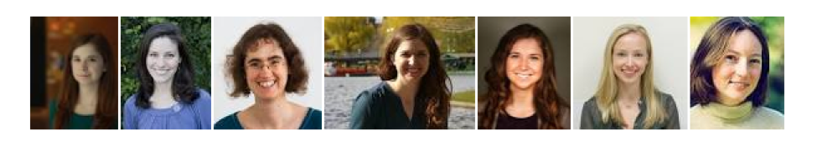
ALISON HILL, PHD
Notes:
In addition to the many places you may choose to promote your work, many of you share first and surnames with other academics, even with the same field. This can contributes to mis-attribution and discovery problems.
ORCID is a machine readable alphanumeric code that uniquely identifies researchers, and facilitate common research workflows...it’s also free and open source.

Slide 17
YOUR SCIENCE IS MORE THAN A LIST OF ARTICLES, SO YOU NEED TO LINK THE OTHER STUFF TO THE RIGHT YOU.

Slide 18
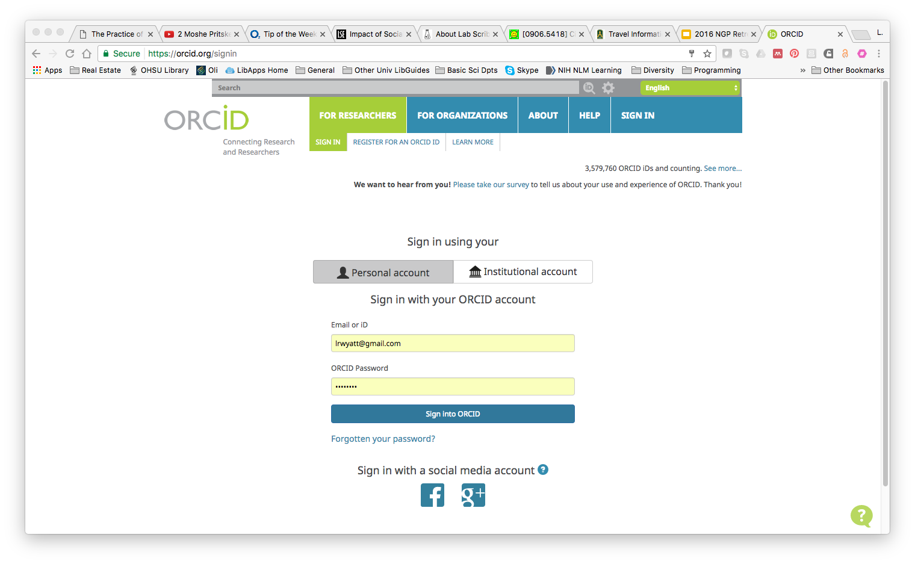
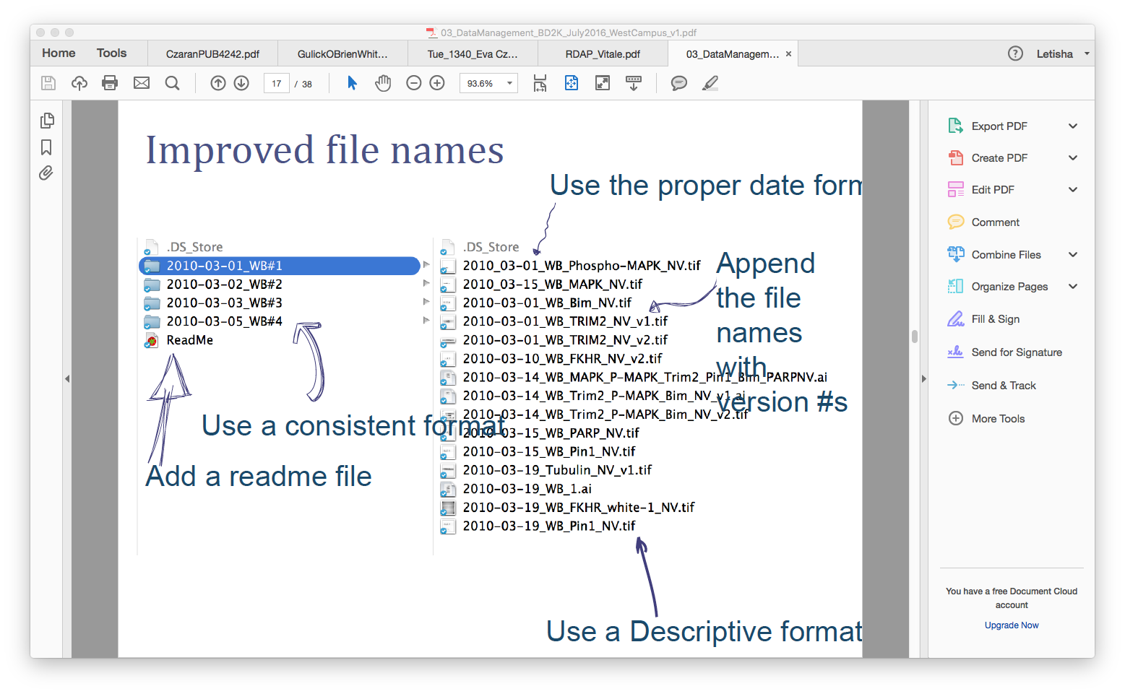
Your researcher ID #
PARTICIPATE: Let’s all get an ORCID!...or make some updates.
Notes:
FIRST: disambiguate!
Where to use it: grant applications, publications, your website, blog, twitter, printed posters, etc
We’ll get a a number and then you’ll need to come back to it to populate your record (link it to Scopus)

Slide 19
SHOW.

Slide 20
YOU ARE MORE THAN A LIST OF ARTICLES, SO YOU NEED TO TELL THE WHOLE STORY.
Notes:
Robin:
Being more strategic about where and how you share and communicate about your work can help you meet your broader impact objectives, especially I they involve engagement with communities outside of academia.
EARLY CAREER SCIENTISTS (this means, highlighting things like):
Developing new scientific ideas
Writing grant proposals
Designing new techniques
Implementing new protocols
Teaching - in the laboratory, classroom, or both
Scholarship (various forms – blogs, editorials, etc.)
Mentorship

Slide 21
The modern scientist develops code in the open, publishes data and code open source, posts preprints, submits to and reviews for traditional journals, but may also write blog posts and use social media....These activities can dramatically increase the profile of scientists, particularly junior scientists, if done well.
Jeff Leek, PhD
Paraphrased from How to Be a Modern Scientist
Associate Professor of Biostatistics
Johns Hopkins Bloomberg School of Public Health
Notes:
Robin

Slide 22
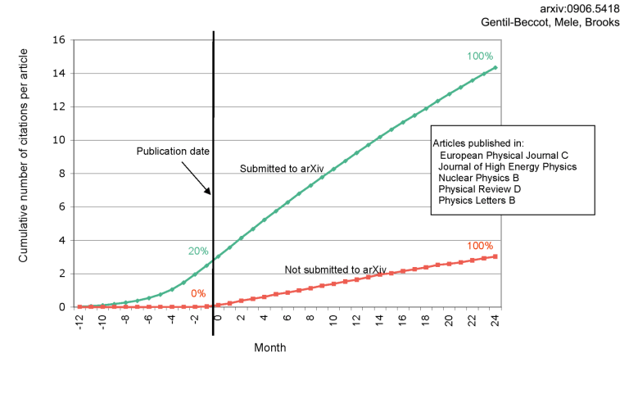
Check out biorxiv.org!
Notes:
increase your impact and outreach with preprints!
Traditional publishing avenues is ancient (300 yrs +) and SLOW!
Some fields are really on top of this trend (physics, math, comp sci)
Looking at Physics journals, by the time a paper is actually published, one that was deposited as a pre-print compared to others that were not had 20% increase in citations!

Slide 23
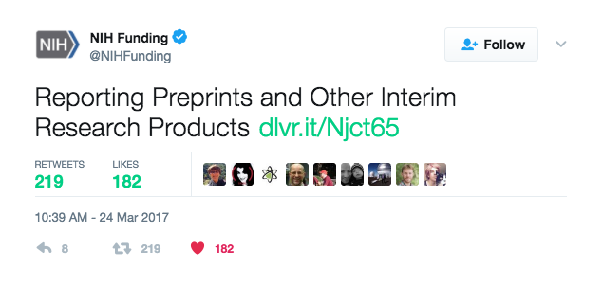
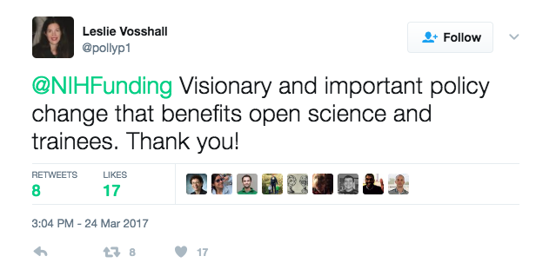
Notes:
The recently announced that it is officially encouraging investigators to use interim research products, such as preprints, to speed the dissemination and enhance the rigor of their work. This important funder along with several others is allowing investigators to cite their interim research products and claim them as products of NIH funding, in reports, biosketches, and proposals. Notably, the NIH is also encouraging investigators to openly publish these products with a CCBY license.
Interim research products includes things like preprints, data, and registered protocols.

Slide 24


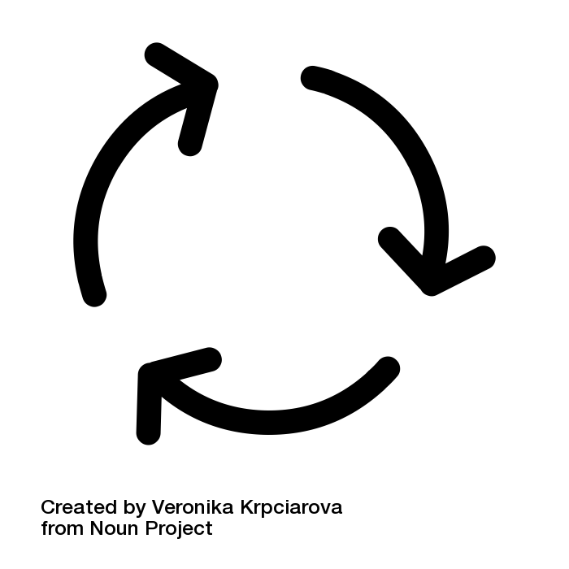
CHOOSE & USE A REPOSITORY THAT PROVIDES:
✔ DISCOVERABILITY (METADATA!)
✔+ OPEN ACCESS
✔ DOI
✔ CITATION STATEMENT
✔+ REUSE RIGHTS WITH A STANDARD LICENSE
Notes:
You can implement all of this by choosing and using a public repository that meets the following criteria.

Slide 25
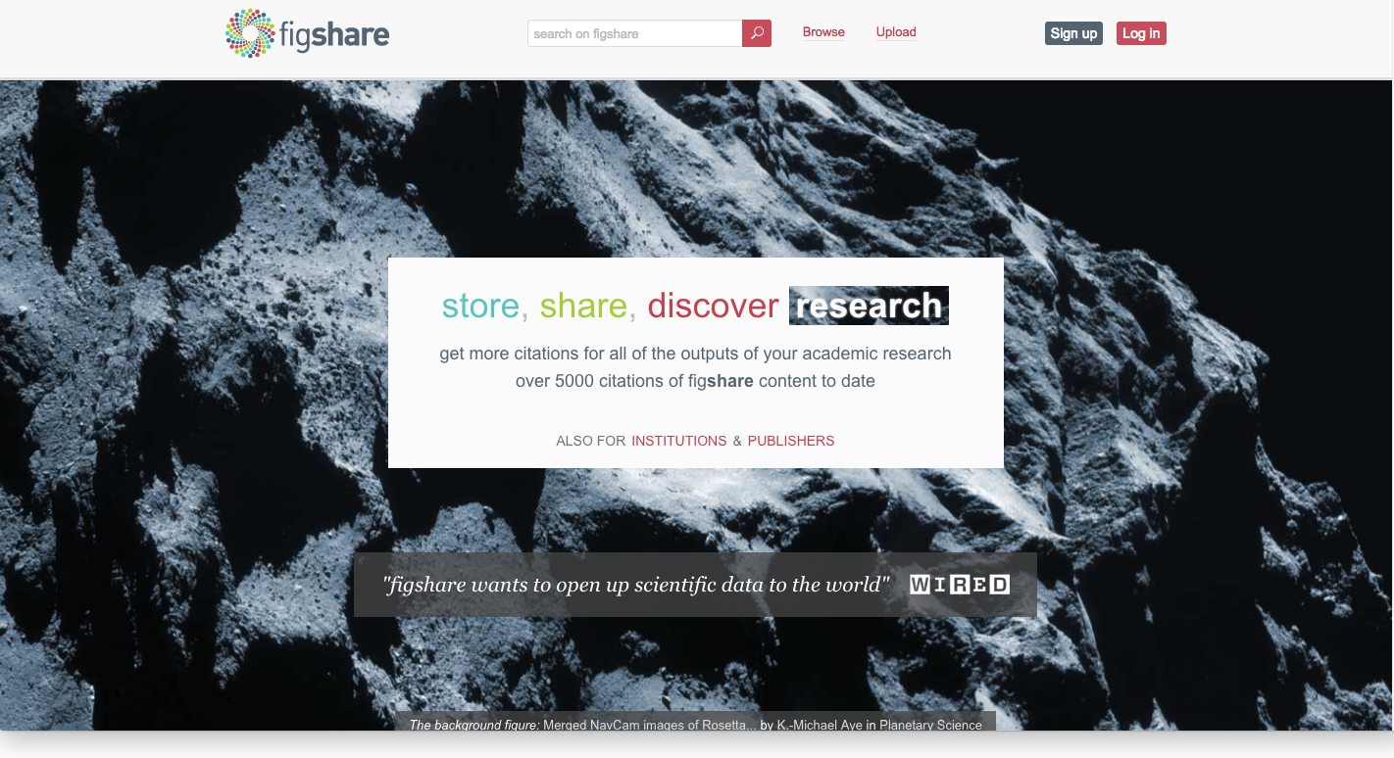
Check out figshare.com & osf.io
Notes:
These provide a doi! Great for sharing research slides/poster presentations to get you started.
Other discipline-specific repository options exist for dois and datasets

Slide 26




http://about.zenodo.org/
✔ DISCOVERABILITY (METADATA!)
✔ OPEN ACCESS
✔ STANDARD LICENSE
✔ DOI
✔ CITATION STATEMENT
https://figshare.com/
http://digitalcommons.ohsu.edu/
https://github.com/

Slide 27
TELL.
Notes:
Workflow ideas:
One idea is to highlight best or most recent work
Research Gate lets you automate alerts to other platforms (i.e., twitter/LinkedIn/Fb) when you add a new paper

Slide 28
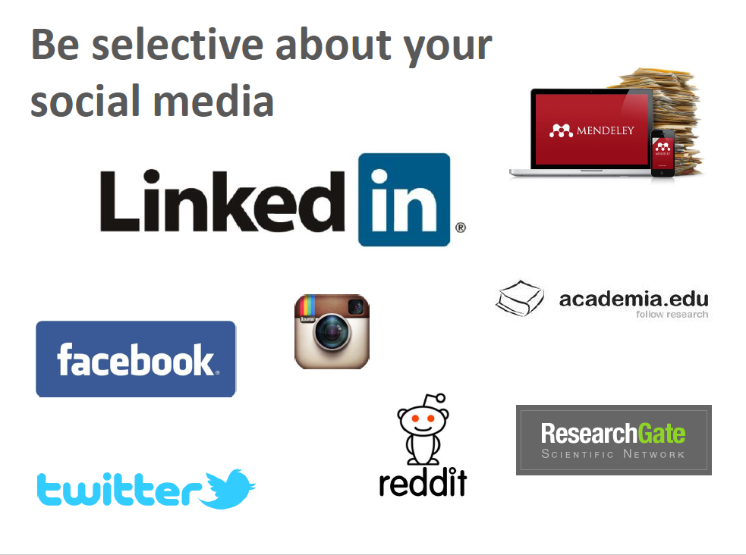

Borrowed from Jean Branan,, Program Coordinator, Career & Postdoctoral Services @ The Scripps Research Institute
Notes:
Benefits of each:
academia.edu = resesearch interests, publications/presentations, and analytical tools (get to later)
research gate = more robust fo connecting with scientists outside of US; like linkedIn, creates networks for you based on citations and those you follow; Q&A section
Google scholar = similar to others but data can be dirtier (search engine-like results) but can export citation material and more automated features
pick one to commit to and engage in it; LIMITATIONS (to all) = these are considered silos in that what goes in to create citation stats doesn’t really come out (other options are ORCID, impactstory)
LinkedIn = job prospecting/networking & relationships (no analytics)
Don’t forget OHSU = your connection to the University - accurate representation is not always easy here -> new lab pages coming soon!

Slide 29
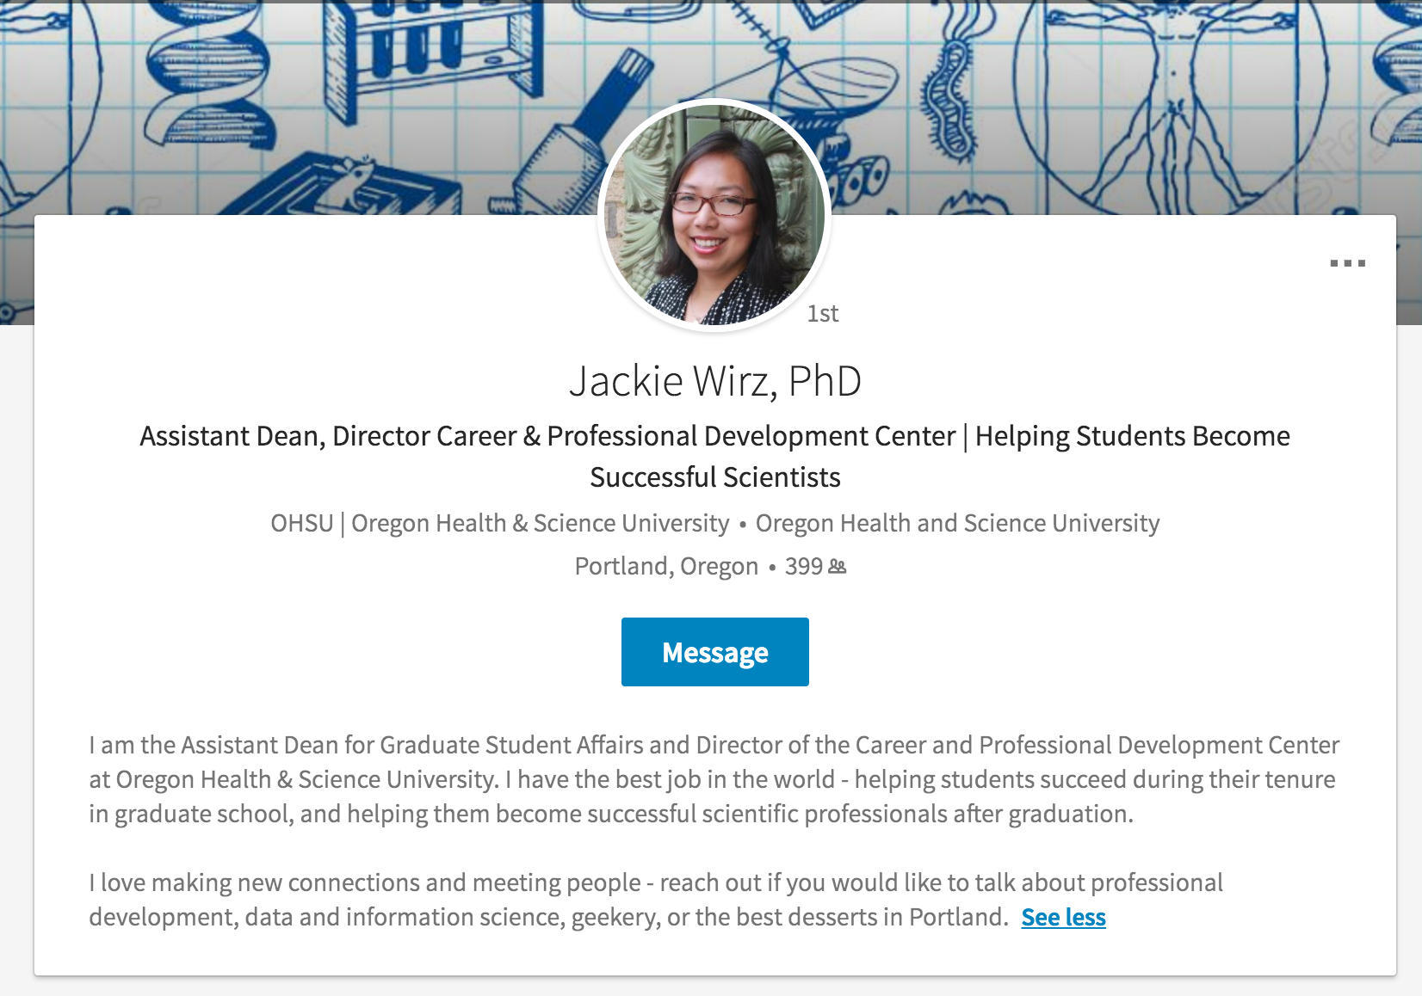


Slide 30
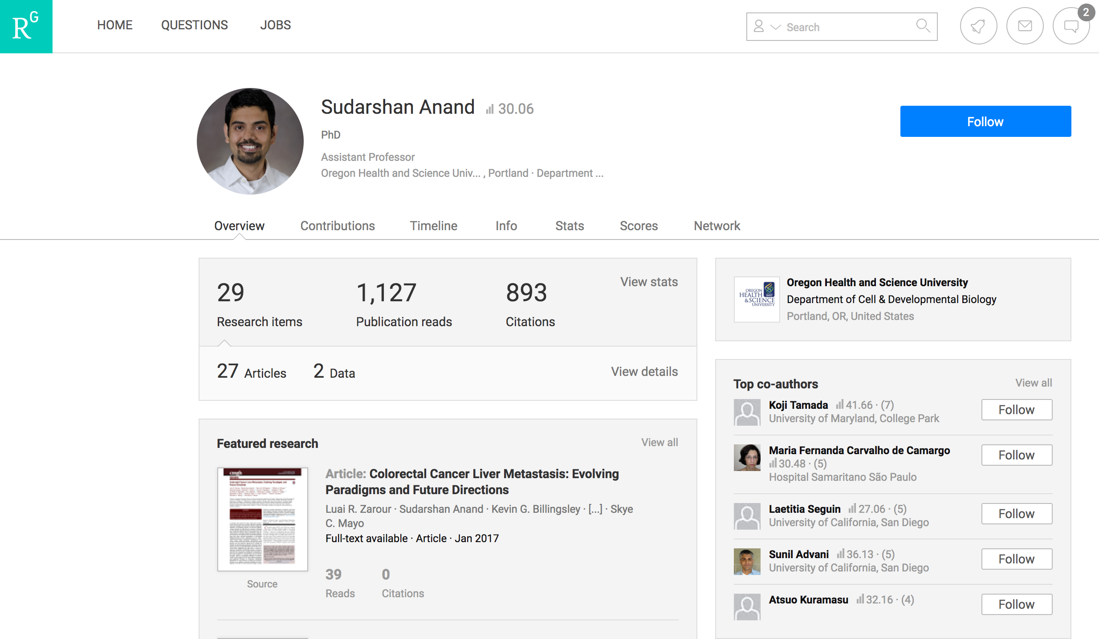

Slide 31
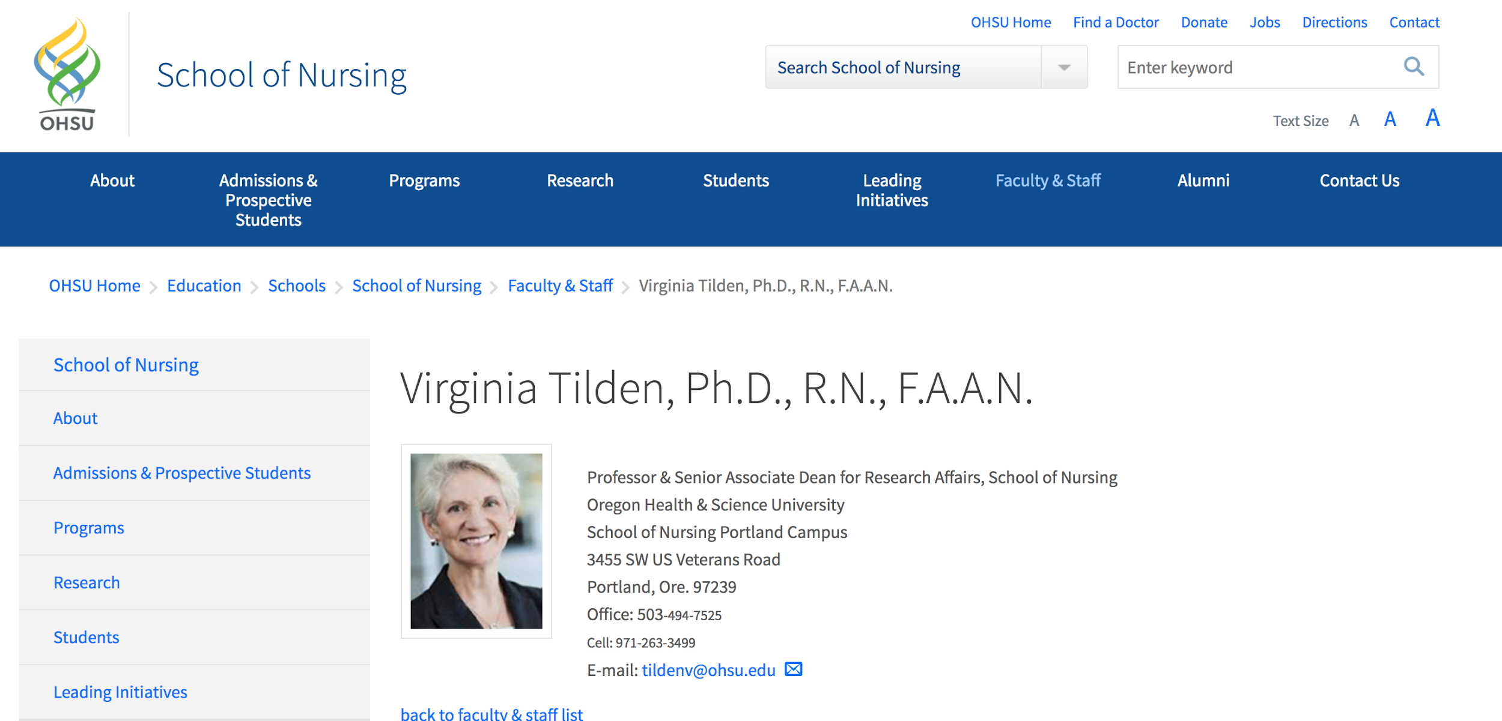

Slide 32
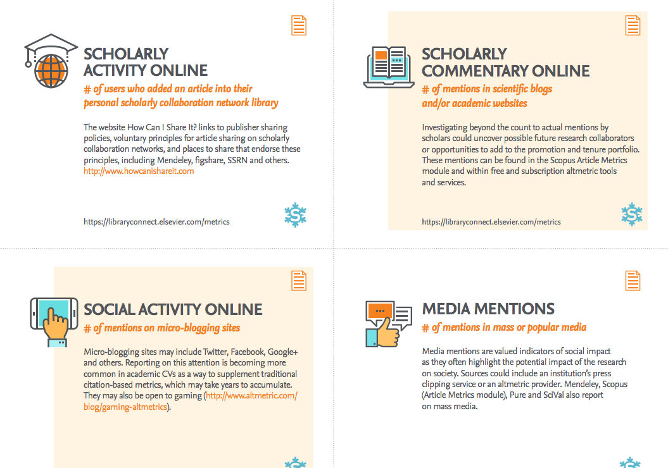
consider multi-media options
Notes:
Think outside the box!
there are many things you’re doing prior to publication that are worth sharing, especially for technicians/grad students & early career researchers: teaching, developing new protocols, new ideas (grant proposals), new techniques, scholarship (writing in some form), mentorship

Slide 33
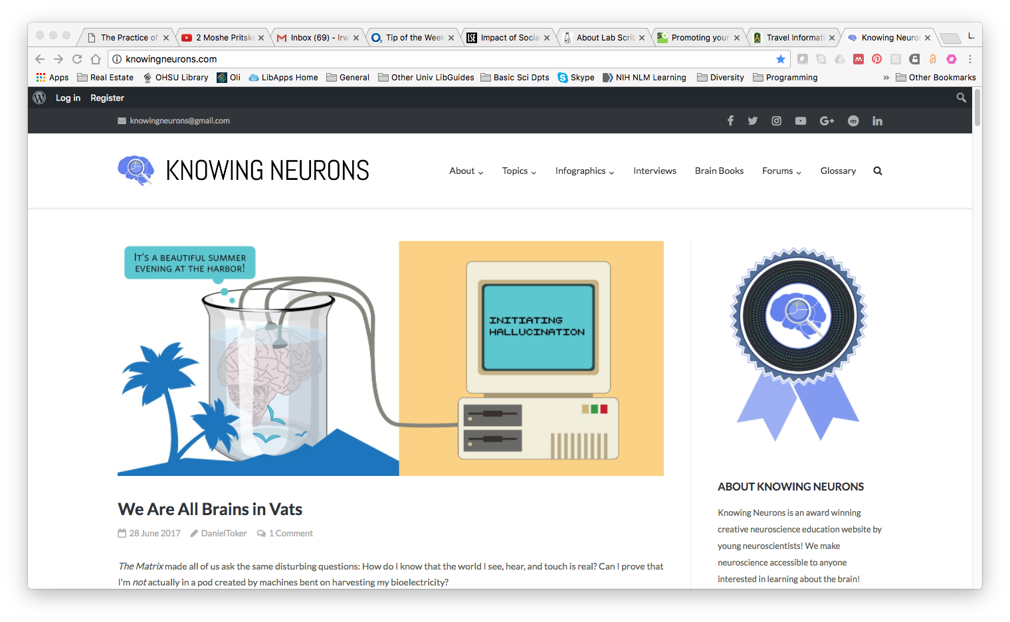
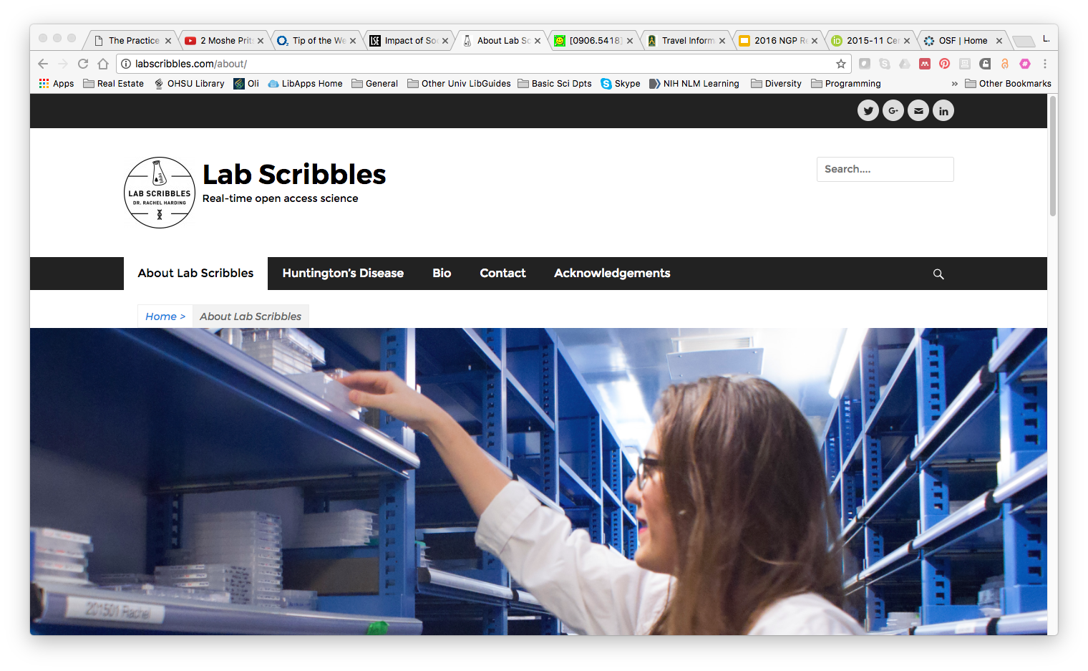
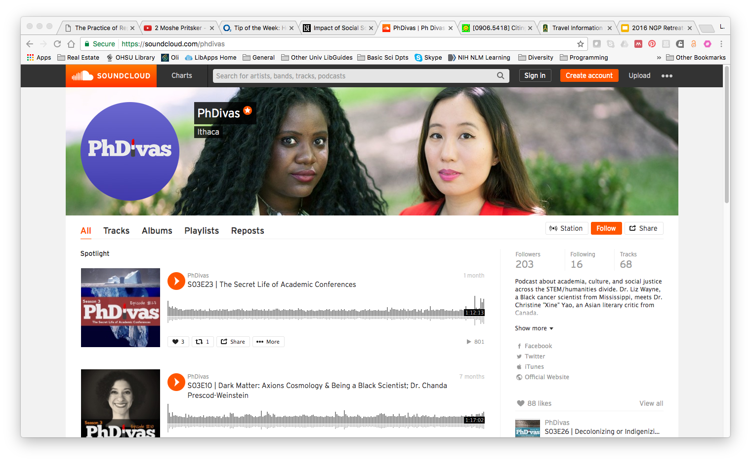
Knowing Neurons
Blog Collection
(education)
Lab Scribbles
Website
(data sharing)
PhDivas Podcast
(academia/culture)
Notes:
Inspiration!

Slide 34
CURATE.
Notes:
Workflow ideas:
Curation efforts will be needed (ORCID is helpful with that - linkout)
One idea is to highlight best or most recent work

Slide 35
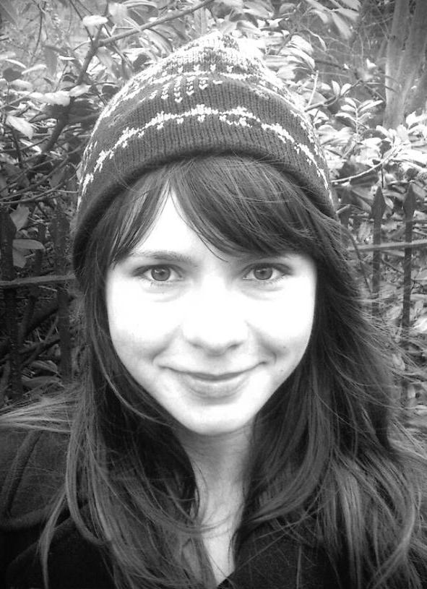
personal professional website
Kathryn Mills
Postdoctoral Fellow
Damien Fair Lab
OHSU
Notes:
A major benefit of a personal website is COMPLETE control. They are particularly great to capture achievements/contributions for early career scientists aside from publications (soft skills/”invisible contributions” highlights).
Explore this great example for design ideas. Look for the elements listed below which are recommended to include, especially for multi-page websites. You can really get a sense of Kathryn’s personality through the design of her web page.
Items to include:
Decent photo
Short bio
Research Interests
Soft skills and personal project contributions
Mentorship/other roles
Publications
Where else to find you

Slide 36
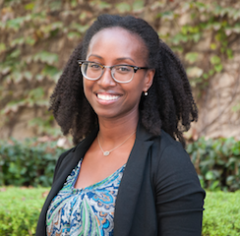
personal professional website
Letisha R. Wyatt, PhD
Basic Science Liaison
Data Management Librarian
OHSU
Notes:
One pager option
Plug and play
LRW website (name clicks out to site) was made using Wix (hosting and domain name all from Wix = $120/yr) - see second link for template! I wanted to at the least have a single page site to get started.

Slide 37
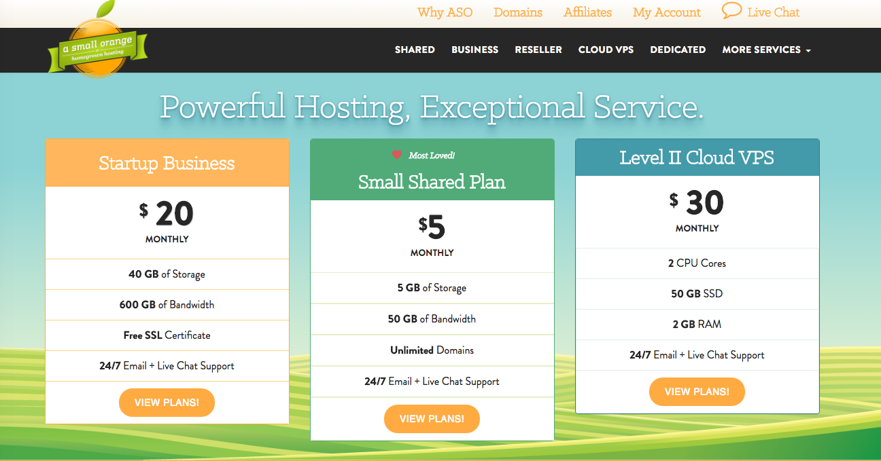
domain names/hosting
Notes:
Benchmarks for you to gauge cost
third party
RC recs the middle one - total cost (including $15 for domain name) = $65/yr
For personalized URLs

Slide 38
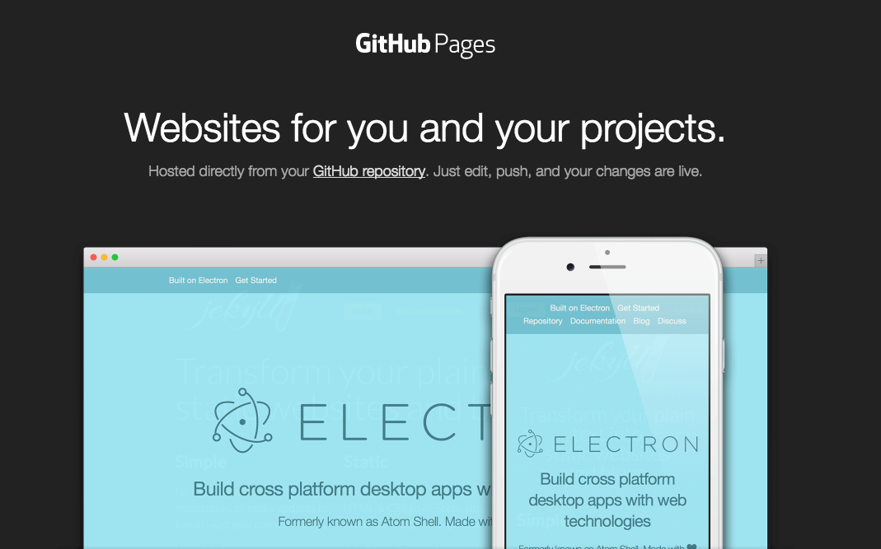
DIY for FREE!!
Notes:
templates available
All files/folders in github repository populates the webpage

Slide 39

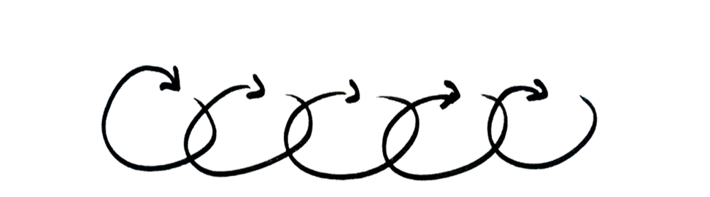
Notes:
Workflow ideas:
Some curation efforts will be needed (ORCID is helpful with that)
One idea is to highlight best or most recent work
Research Gate lets you automate alerts to other platforms (i.e., twitter/LinkedIn/Fb) when you add a new paper

Slide 40
STEP 1:
YOU NEED A GOOD BIO
Notes:
Robin:
And likely a few different versions!

Slide 41
the basics
Your bio is not your Biosketch.
Your bio is not a list of everything you’ve done.
Your bio is a communication tool.
Your bio tells a story of your credibility, interests, current activities, and accomplishments.
Your bio should be concise, serving as an abstract of your professional self.
Notes:
Letisha:
Don’t use your bio to recount your entire career–that’s what your CV is for. Instead, be sure to state the most important thing about yourself first and foremost, and fill in the rest with broad strokes. Who are you and what makes you tick as a researcher? What have your most important accomplishments been to date? Write a paragraph or two, and then take a knife to it, cutting it down to bare essentials.

Slide 42
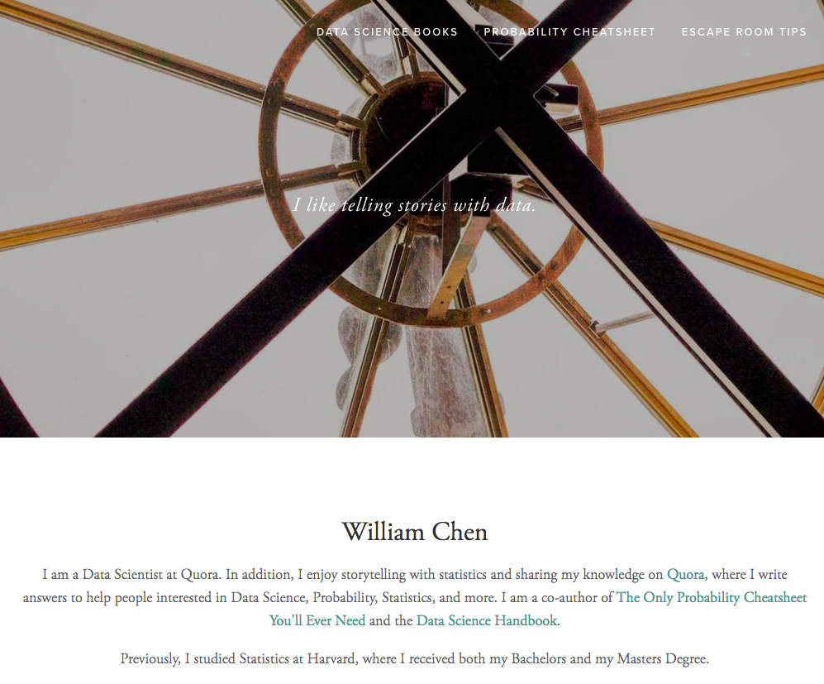
short form
Notes:
Letisha:
accessible

Slide 43
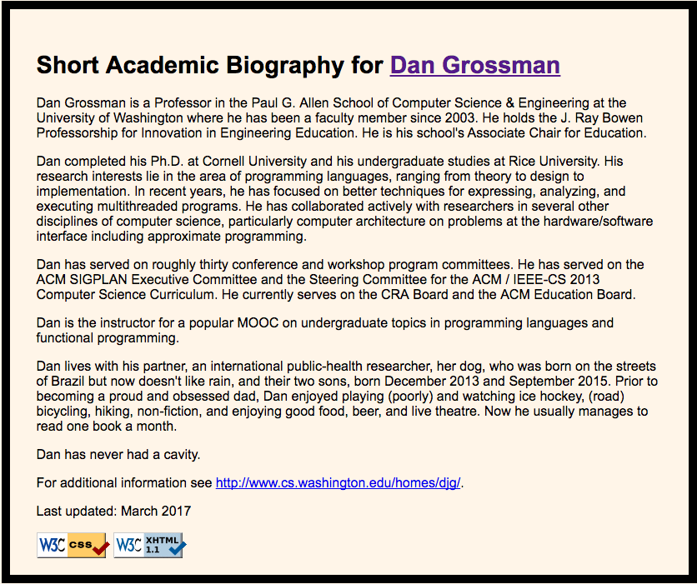
mid form
Notes:
Letisha:
*images hyperlinked
although CS/CE it’s easy to understand
highlight the things we know about Dan - we’ll break down more of these elements during the workshop
additional example (missing some elements): http://cosmo.nyu.edu/hogg/bio.html

Slide 44
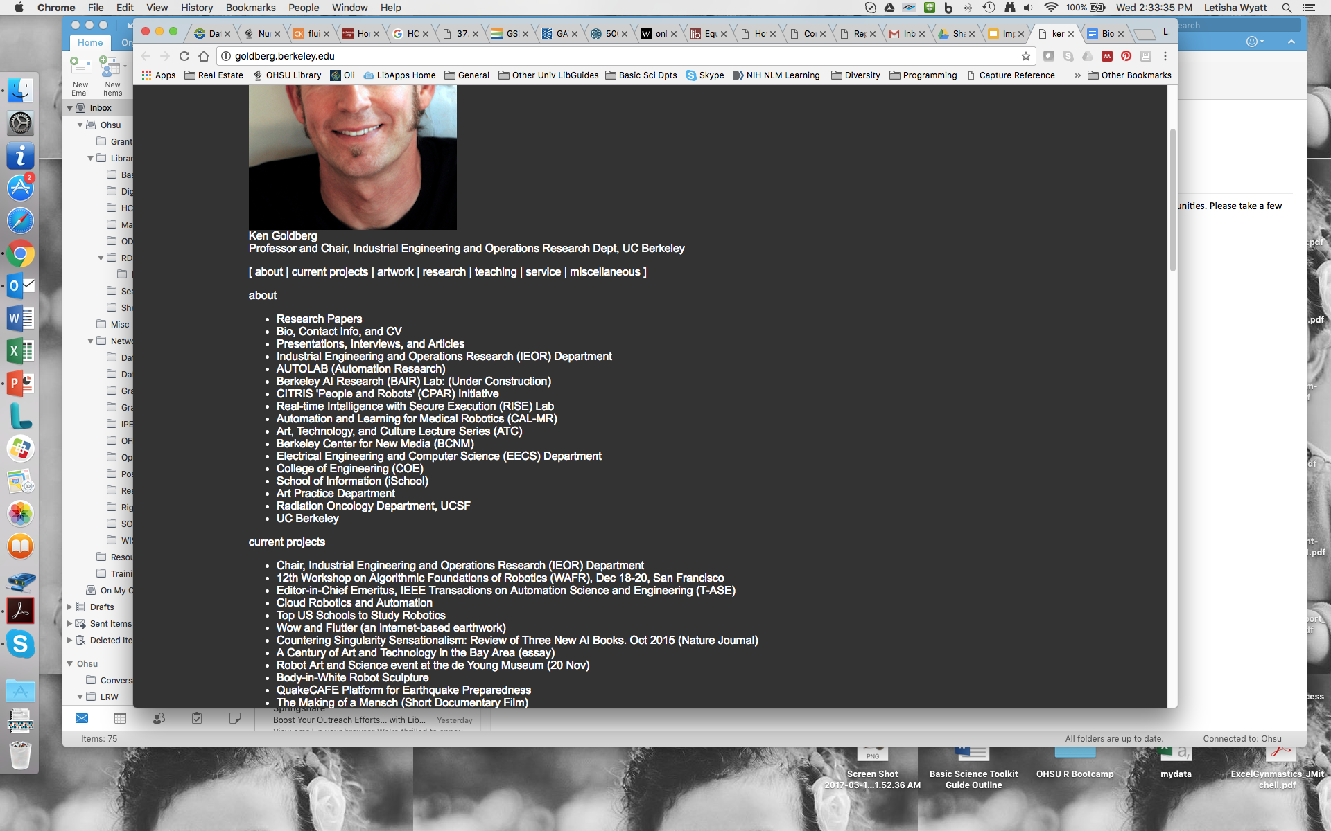
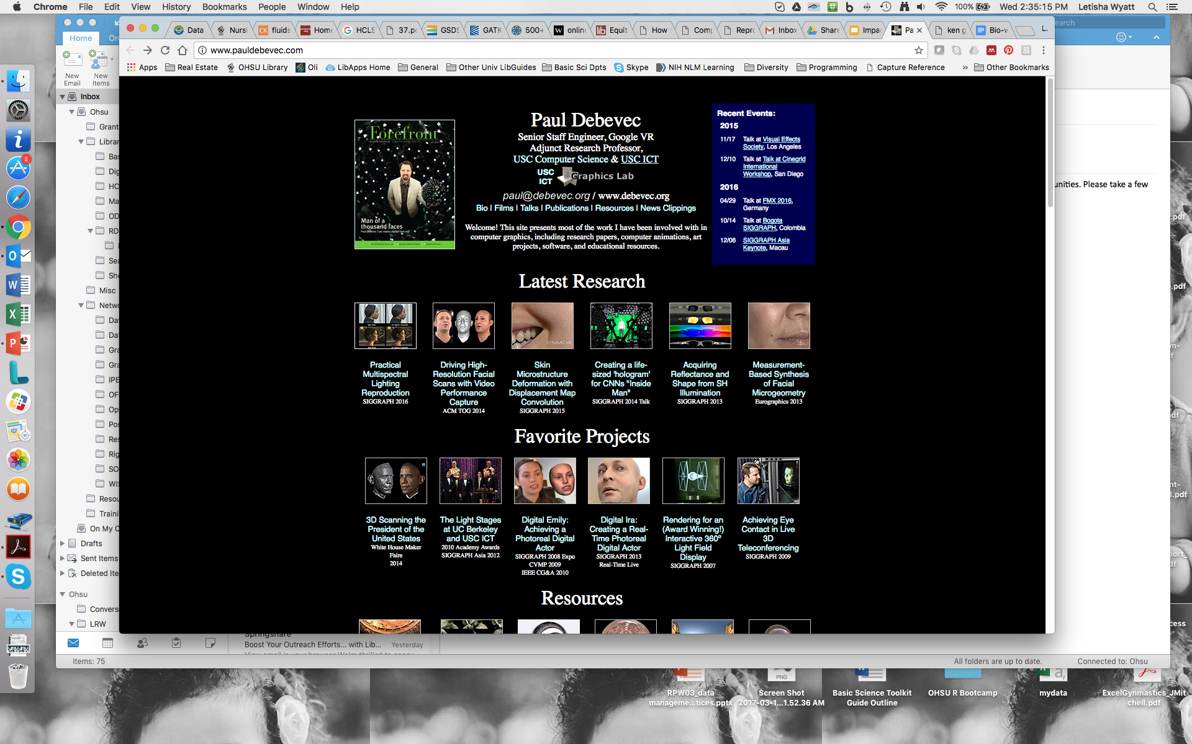
just don’t…
Notes:
Letisha
Lists!
Visuals are good but this doesn’t tell us anything about Paul
Must be an engineer to get it

Slide 45
YOUR TURN…
BRAINSTORM YOUR INVENTORY
Notes:
Activity of brainstorming category keywords/phrases (worksheet)
Think of the context of this exercise as a LinkedIn bio

Slide 46
CREDIBILITY
INTERESTS
CURRENT ACTIVITIES
ACCOMPLISHMENTS
Notes:
10 minutes for individual brainstorming.
brain dump the ingredients for the recipe we’ll put together
this is your inventory

Slide 47
DON’T OVERLOOK WHAT YOU KNOW...
RESEARCH & ANALYTICAL SKILLS
WHAT IT TAKES TO ADVANCE
& FINISH
LOCATE & ASSIMILATE LOTS OF INFO
UNDERSTAND COMPLEX CONTENT
THINK ON YOUR FEET
INTELLECTUAL INDEPENDENCE
PROBLEM SOLVE
PERFORM UNDER PRESSURE
FOCUS
LEARN & ADAPT
MEET HIGH EXPECTATIONS
INTERPERSONAL & COMMUNICATION SKILLS
ENTREPRENEURIAL SKILLS
LEAD
COPE WITH & MANAGE COMPLICATED PERSONALITIES
THRIVE IN COMPETITIVE ENVIRONMENTS
CONVEY COMPLEX INFO
WORK INDEPENDENTLY
ACQUIRE FUNDING
PROTOTYPE NEW IDEAS
Adapted from Jean Branan,, Program Coordinator, Career & Postdoctoral Services @ The Scripps Research Institute
Notes:
Might be challenging for early-career researchers but consider these things (themes)
These soft skills undoubtedly relate to jobs and can be pulled from a multitude of early career accomplishments and activities.

Slide 48
YOUR TURN…
PRIORITIZE & DRAFT THE ESSENTIAL ELEMENTS
Notes:
10 MINUTES FOR ONE ROUND OF WRITING.

Slide 49

PHRASE BRAINSTORM
Draft 1-2 sentences to represent yourself in each category below
Credibility:
Interests:
Skills:
Goals:
Contributions:
Collaborations:
Recognition/Awards:

Slide 50
CONSIDER...
WHY ARE YOU AN EXPERT?
HOW WOULD YOU EXPLAIN WHAT YOU DO?
WHAT WOULD YOU BRAG ABOUT?
WHO DO YOU WORK WITH?
WHAT DO YOU BRING TO THE TABLE?
WHAT DO YOU WANT TO ACHIEVE?
DON’T FORGET…YOUR ACTIVE VERBS

Slide 51
YOUR TURN…
TURN IT INTO A STORY
Notes:
Activity - writing narratives (15 min)
Piecing it all together into a cohesive story

Slide 52
Explain what you do + Establish credibility +
Describe your professional or research interests + Brag a little + Call to action
Approach adapted from Stacy Konkiel : https://www.altmetric.com/blog/building-your-online-reputation/
Notes:
It can be difficult to talk about yourself. Here’s a really simple formula to help get you started
Your bio should have these elements
You are not tied to this formula, feel free to move the pieces around to tell your story

Slide 53
Letisha R. Wyatt is the Basic Science Liaison and Research Data Management Librarian at Oregon Health & Science University. She holds Ph.D. in Molecular Pharmacology & Toxicology from the University of Southern California (2013). Her research focuses on the genetic regulation of the brain’s response to drugs. Letisha is a former NIH predoctoral fellow and has strong record of mentorship in the laboratory and classroom She works to support the information needs of the OHSU basic science community, facilitating efficiency, impactful research practices, and problem solving across the research and data lifecycles. Read more about Letisha’s role on her departmental webpage and find her on twitter: @dr_lrwyatt.
Notes:
Here’s Letisha’s bio
This six-sentence bio was HARD!!
Robin edited it ruthlessly

Slide 54
YOUR TURN…
(PEER) REVIEW TIME
Notes:
Activity - Tweak it (10 min)

Slide 55
LOOK FOR...
JARGON
It turns the reader off
Ask, is this meant to be technical? If not, summarize the point in layman’s terms
If you must, make it interesting
PASSIVE VOICE
Puts actor before action (common practice in primary publication)
Makes it harder for reader to follow for mental processing reasons
SOPORIFIC LANGUAGE
Slows the momentum of your writing b/c these are often meaningless and vague uses
Examples: “there is/are”, “it is/was”, ”in fact, indeed”, “a number of”
Notes:
jargon: readers typically want to talk about and share what they’ve read. it’s the reason for their engagement…reward goes out the window if they cannot understand the terminology

Slide 56
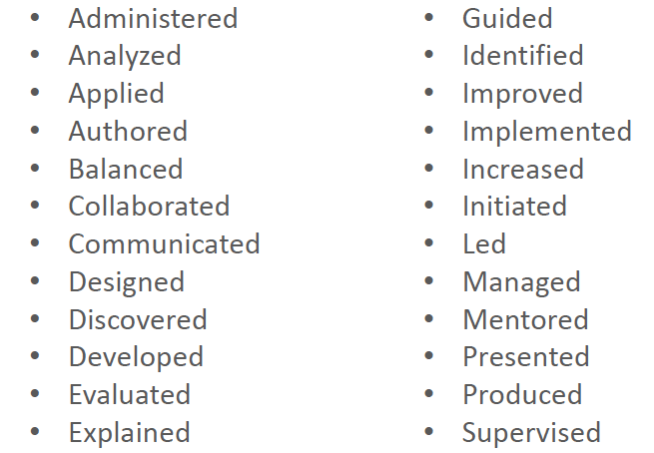
active verbs
Borrowed from Jean Branan,, Program Coordinator, Career & Postdoctoral Services @ The Scripps Research Institute
Notes:
Here are some great verbs to use!

Slide 57
STEP 2:
VERSION IT
Notes:
Robin:
And likely a few different versions!

Slide 58
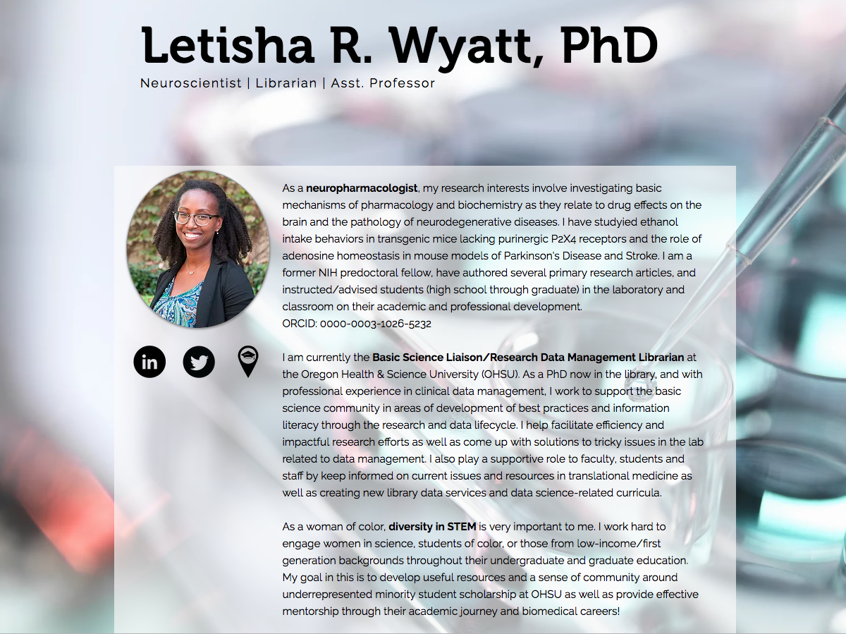
Notes:
Long form example

Slide 59

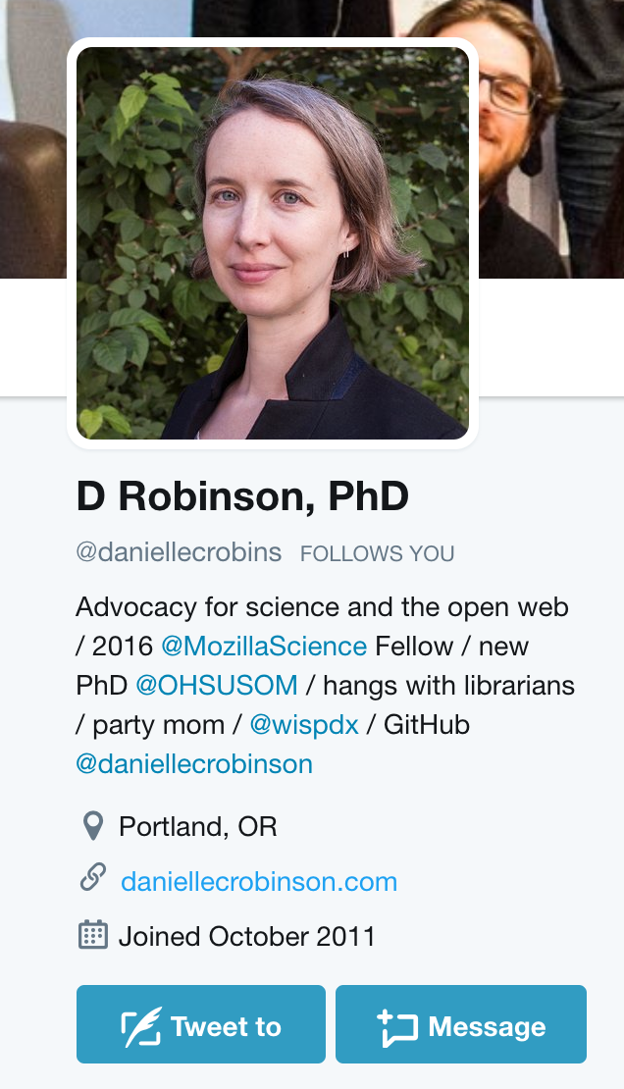
A CONSISTENT, PROFESSIONAL PHOTO
A HANDLE THAT CLEARLY IDENTIFIES YOU OR YOUR EXPERTISE
SHORT BIO (160 CHARACTERS).
CONSIDER INCLUDING:
ACADEMIC INTERESTS
AFFILIATIONS
#HASHTAGS
“OPINIONS ARE MY OWN” STATEMENT
LINK TO ADDITIONAL INFO
Adapted from: http://blog.impactstory.org/research-impact-challenge-ebook/
Notes:
First, you need to create a professional Twitter profile.
A couple of suggestions about usernames are that they should be (a) unique enough that they will
likely be available across platforms, (b) personal to you, but not too cute, and (c) as short as possible
so that people will be able to easily remember them. One common option is to use your first two
initials and your last name, particularly if your last name is short. Alternative options include using
just your first and last name separated by a period, just your first name if it is sufficiently unique,
or a nickname that you wouldn’t be embarrassed telling your professional colleagues.

Slide 60
STEP 3:
USE IT, WE CAN HELP
HTTP://TINYURL.COM/OHSUIMPACTCHALLENGE
Notes:
Websites, set up with GH Pages (Thurs 7/13 4-5:30 PM)!

Slide 61
resources
OHSU IMPACT CHALLENGE
30 DAY IMPACT CHALLENGE
HOW TO BE A MODERN SCIENTIST
YOU’VE GOT SOME EXPLAINING TO DO

Slide 62
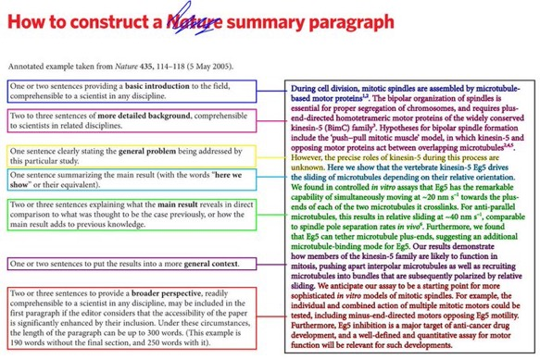
Apply: summary paragraph ~ 500 words
Notes:
How will you use this (in part/whole) for your outreach?

